Slide 1
Foreign Exchange
Principles of Macro Economics 2
ECONA 202

Slide 2
Definition of Foreign Exchange
Foreign Exchange is the trading of one currency for another. For example, one can swap the U.S. dollar for the euro. Foreign exchange transactions can take place on the foreign exchange market.

Slide 3
Exchange Rate
An exchange rate is the rate at which one currency can be exchanged for another between nations or economic zones. It is used to determine the value of various currencies in relation to each other and is important in determining trade and capital flow dynamics.
For example 1 dollar = 80 rupees

Slide 4
Fixed Exchange Rate
A fixed exchange rate is a regime applied by a government or central bank that ties the country's official currency exchange rate to another country's currency or the price of gold. The purpose of a fixed exchange rate system is to keep a currency's value within a narrow band.

Slide 5
Flexible Exchange Rate
Flexible exchange rate system is the exchange system where the exchange rate is dependent upon the supply and demand of money in the market. In a flexible exchange rate system, the value of the currency is allowed to fluctuate freely as per the changes in the demand and supply of the foreign exchange

Slide 6
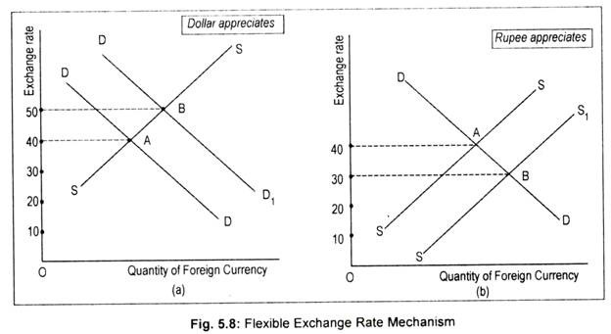

Slide 7


